Slide 1
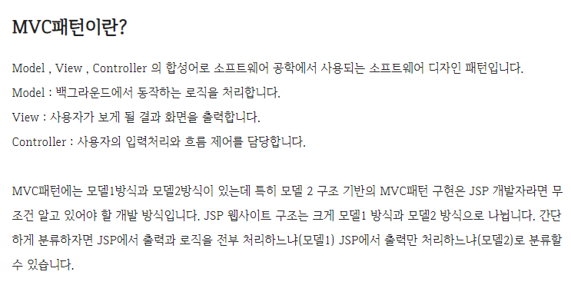
https://sj1004class.tistory.com/51 참고

Slide 2
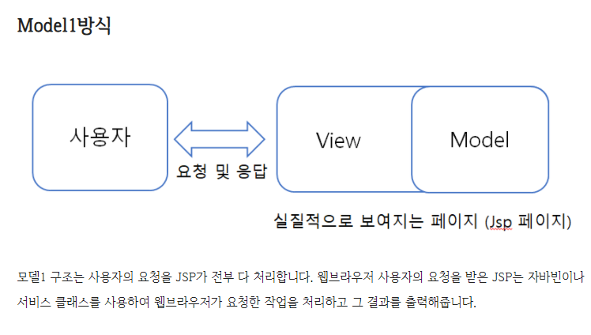


Slide 3
